Slide 1
VALUATION VERSUS VALUE

Slide 2
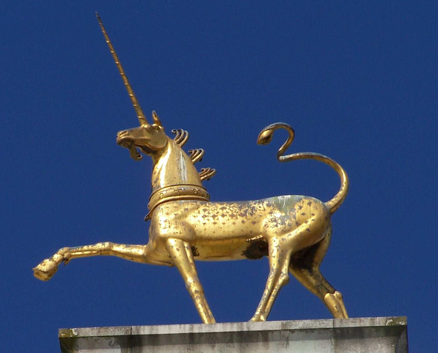
The Rise of the Unicorns
u·ni·corn
[ˈyo͞onəˌkôrn]
NOUN
a private VC-backed company
with valuation over $1 billion

Slide 3
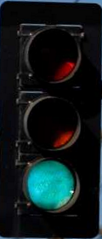
Do you believe in Unicorn valuations?
Are unicorns overvalued or undervalued?
Overvalued?
Fairly valued?
Undervalued?

Slide 4
Do you believe in Unicorn valuations?
92% of venture capitalists say unicorns are overvalued
93% of VCs invested in unicorns
87% of IT VCs
92% of top VCs
90% of California VCs
93% of late-stage VCs
Source: Gompers, Gornall, Kaplan, Strebulaev (2019)

Slide 5


“That would make it the third-most-valuable publicly traded office landlord were it publicly traded, despite controlling a fraction of the square footage of the leading companies in the sector.”
1st March 2016
$430M raised
$16B Valuation

Slide 6

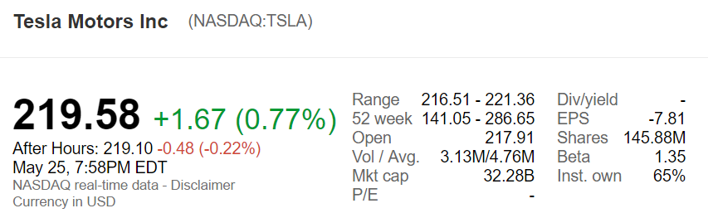
What is valuation?
Public company:
Valuation = Market cap = Price of one share × Number of shares
Value of Tesla is $32 billion = $219.58 × 146 million

Slide 7
Post-money valuation
Does $16 Billion WeWork Valuation = Market cap?
NO
Public company:
Valuation = Market cap = Price of a share × Total number of shares
Private VC-backed company:
Valuation = Market cap = Price of a share × Total number of shares
Post-Money Valuation =
Price of a preferred share × Total number of common shares

Slide 8


Founder/Employee shares vs VC Shares
A preferred share
is more valuable than
a common share or a stock option

Slide 9


Classical approach to a “post-money value”
Unicorn Inc. just sold a preferred share for $10
Therefore each share in the company is worth $10
The company is made up of 3 common shares and 2 preferred shares
Therefore the company is worth $50 = 5 x $10
SOLD $10
SOLD $10
$10
$10
$10
$10

Slide 10
Fair value approach to valuation
Unicorn Inc. just sold a preferred share for $10
Therefore each share in the company is worth $10
SOLD $10
SOLD $10
$10 $3
$10 $3
$10 $3
$10 $6

Slide 11
Fair value approach to valuation
In reality, different shares are worth different amounts.
The company is worth $50 = 5 x $10 $25 = $3 + $3 + $3 + $6 + $10
SOLD $10
$10 $3
$10 $3
$10 $3
$10 $6

Slide 12

Contractual terms and payouts
Convertible preferred added
features of participation
and a 2x liquidation multiple
Standard convertible preferred

Slide 13

Post-money valuation is implied by contractual terms
SOLD $10
Unicorn Inc. just sold a preferred share for $10
The “classic” approach to valuation says the company is worth $50
But preferred shares have additional features that increases their value (at the expense of common shareholders) …
Suppose a preferred share promises investors at least twice their money back (at the expense of common) and sells for $20 due to that extra promised payoff.
That leads to a post-money valuation of
$100 = 5 x $20.
SOLD $20

Slide 14
Gornall Strebulaev (2019) Valuation Framework for Unicorns
Valuation framework that allows to value each unicorn
Applying framework to 135 U.S. unicorns
Carefully analyzing contracts between firms and investors

Slide 15

Overvaluation of unicorns
Square
Result: Half of unicorns
lose their unicorn status
Source: Gornall & Strebulaev (2019)

Slide 16
SpaceX Post-Money Value vs. Fair Value
Source: Gornall & Strebulaev (2019)

Slide 17
SpaceX Post-Money Value vs. Fair Value II
Source: Gornall & Strebulaev (2019)

Slide 18
SpaceX Post-Money Value vs. Fair Value III
Series D investors were guaranteed
2x their money back, more than 100% overvaluation
Source: Gornall & Strebulaev (2019)

Slide 19
SpaceX Post-Money Value vs. Fair Value IV
Series E investors “participate” and are senior, about 100% overvaluation
Source: Gornall & Strebulaev (2019)

Slide 20
SpaceX Post-Money Value vs. Fair Value V
Source: Gornall & Strebulaev (2019)

Slide 21
SpaceX Post-Money Value vs. Fair Value VI
Series G investors can get their money back at any time,
60% overvaluation
Source: Gornall & Strebulaev (2019)

Slide 22
(Simple!) Example of a VC backed company
LiquidX Pharmaceuticals needs $50M to develop a drug.
The company will be sold in one year
For $500M if its drug is successful
For $100M if its drug fails (still valuable as more drugs are under investigation)
$500M
p
($50M)
1-p
$100M

Slide 23
LiquidX Financing
Initially, its founder owns 100% and has 15 million shares
A VC invests $50M at $350M post-money valuation
The VC receives standard CPS with 1X LP
What is the fair value of
LiquidX Pharmaceuticals?

Slide 24
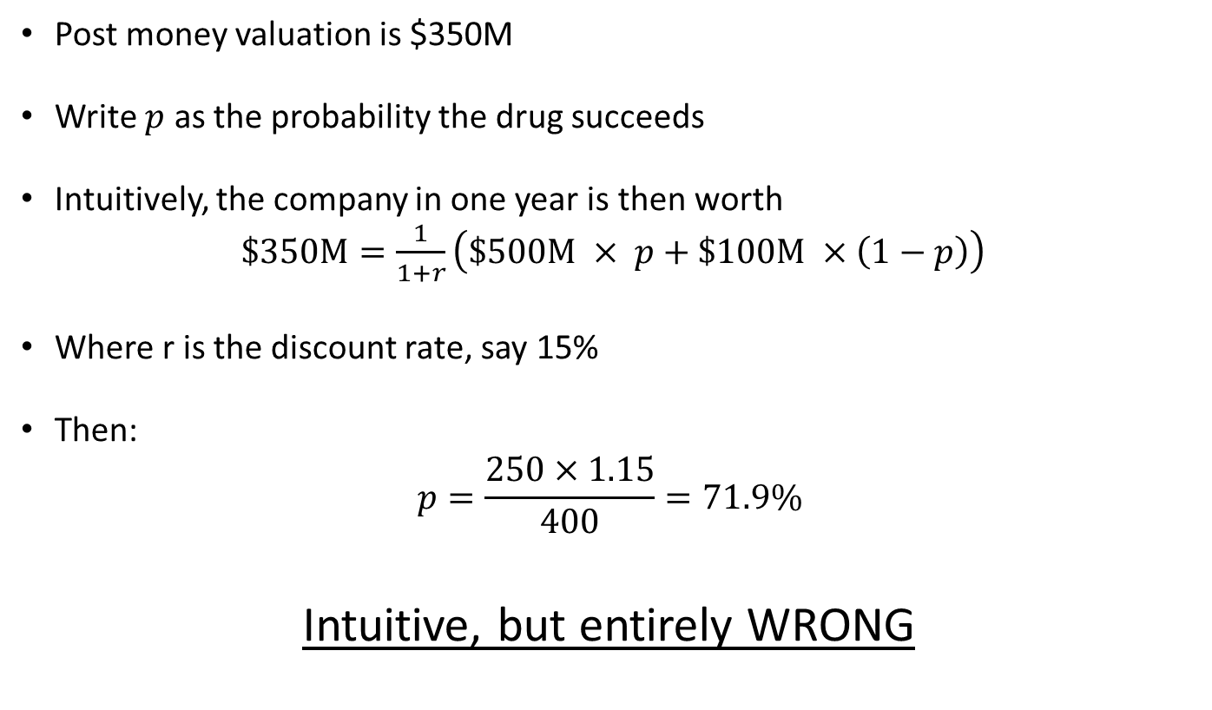
LiquidX probability of success?
Post money valuation is $350M
Write $p$ as the probability the drug succeeds
Intuitively, the company in one year is then worth
$\$350M=\frac{1}{1+r}\left(\$500M × p+\$100M ×\left(1−p\right)\right)$
Where r is the discount rate, say 15%
Then:
$$p=\frac{250×1.15}{400}=71.9\%$$
Intuitive, but entirely WRONG

Slide 25
LiquidX: Cap table
Pre-money valuation: $300M
Number of shares pre-money: 15 million shares
VC invested at $20 per share to buy 2.5 million shares
$20 x 2,500,000=$50M
 | Shares | Invested | Fully-Diluted Ownership
Founder | 15,000,000 Common |  | 85.71%
VC | 2,500,000 Preferred | $50 m | 14.29%
Total | 17,500,000 |  | 100%

Slide 26
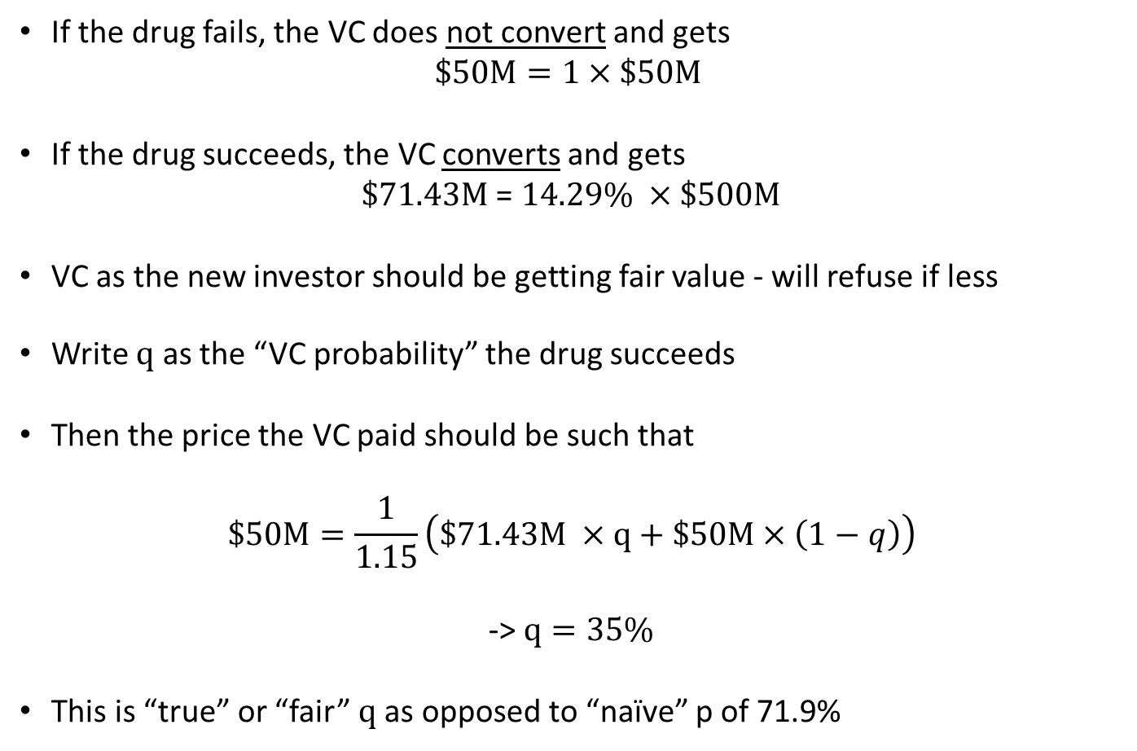
LiquidX: VC Conversion decision
If the drug fails, the VC does not convert and gets
$$\$50M=1×\$50M$$
If the drug succeeds, the VC converts and gets
$\$71.43M$ = $14.29\% ×\$500M$
VC as the new investor should be getting fair value - will refuse if less
Write $q$ as the “VC probability” the drug succeeds
Then the price the VC paid should be such that
$$\$50M=\frac{1}{1.15}\left(\$71.43M ×q+\$50M×\left(1−q\right)\right)$$
-> $q=35\%$
This is “true” or “fair” $q$as opposed to “naïve” p of 71.9%

Slide 27
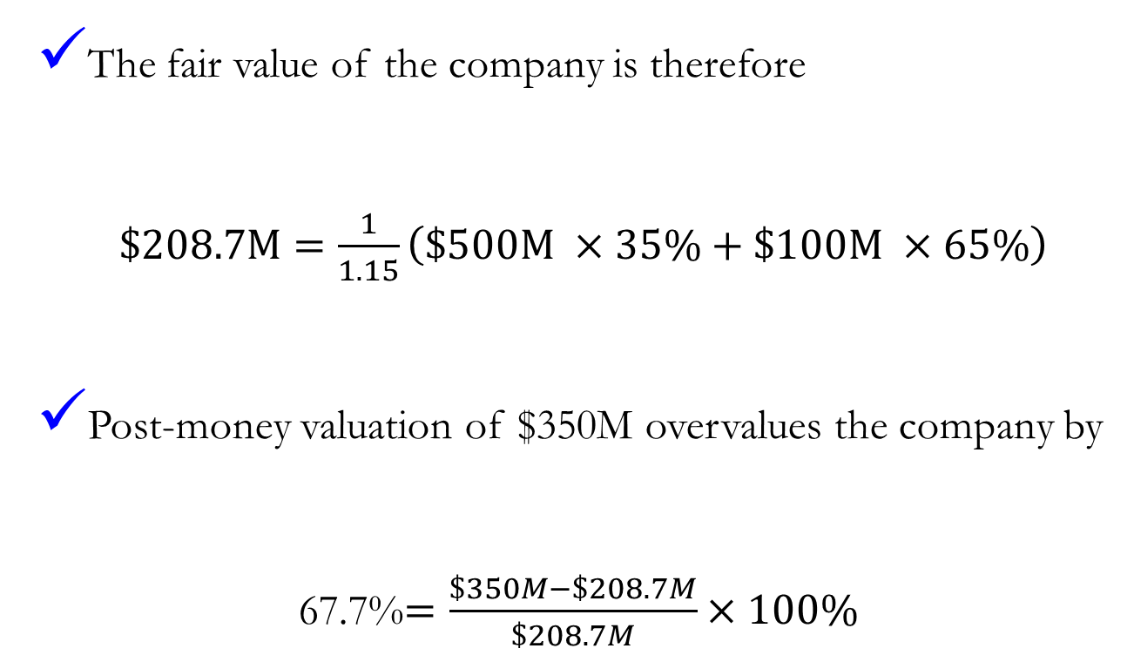
LiquidX: Fair value of the company
The fair value of the company is therefore
$\$208.7M=\frac{1}{1.15}\left(\$500M ×35\%+\$100M ×65\%\right)$
Post-money valuation of $350M overvalues the company by
67.7%$=\frac{\$350M−\$208.7M}{\$208.7M}×100\%$

Slide 28
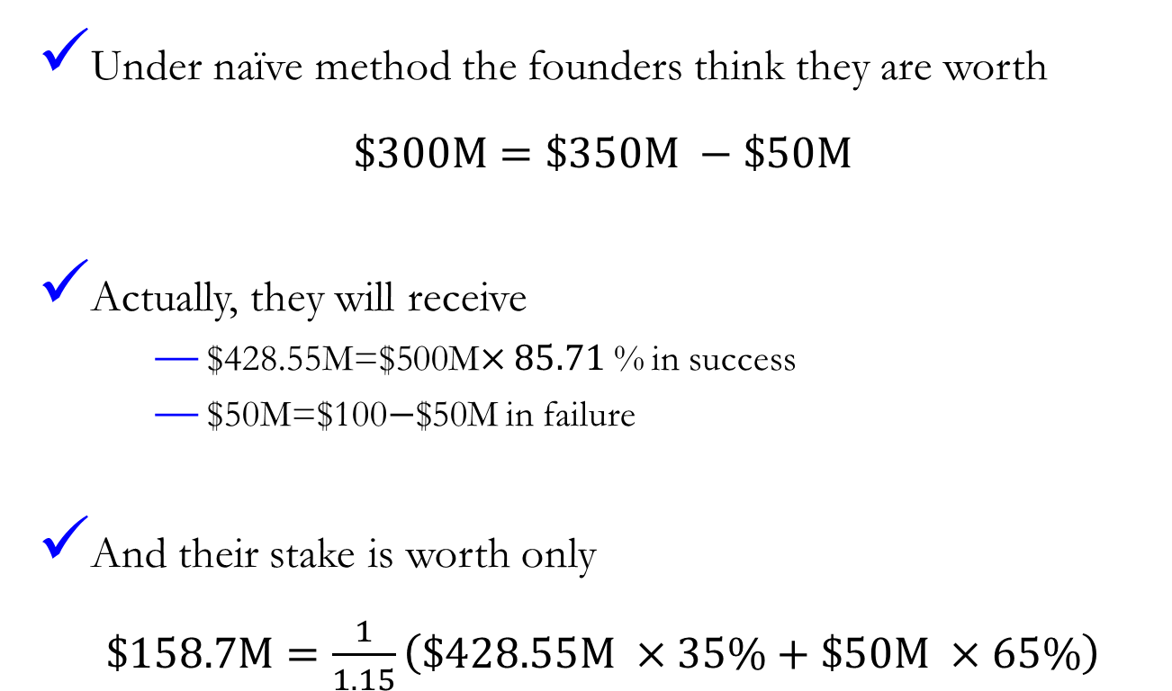
Founder value in LiquidX example
Under naïve method the founders think they are worth
$\$300M=\$350M −\$50M$
Actually, they will receive
$428.55M=$500M$×85.71$% in success
$50M=$100$−$$50M in failure
And their stake is worth only
$\$158.7M=\frac{1}{1.15}\left(\$428.55M ×35\%+\$50M ×65\%\right)$

Slide 29
LiquidX: How to become a Unicorn???
LiquidX Founder desperately wants LiquidX to be a unicorn
He offers VC the same security but with participation
q is still 15% (because fair value is unchanged by financial tricks)
What is the post-money value?

Slide 30
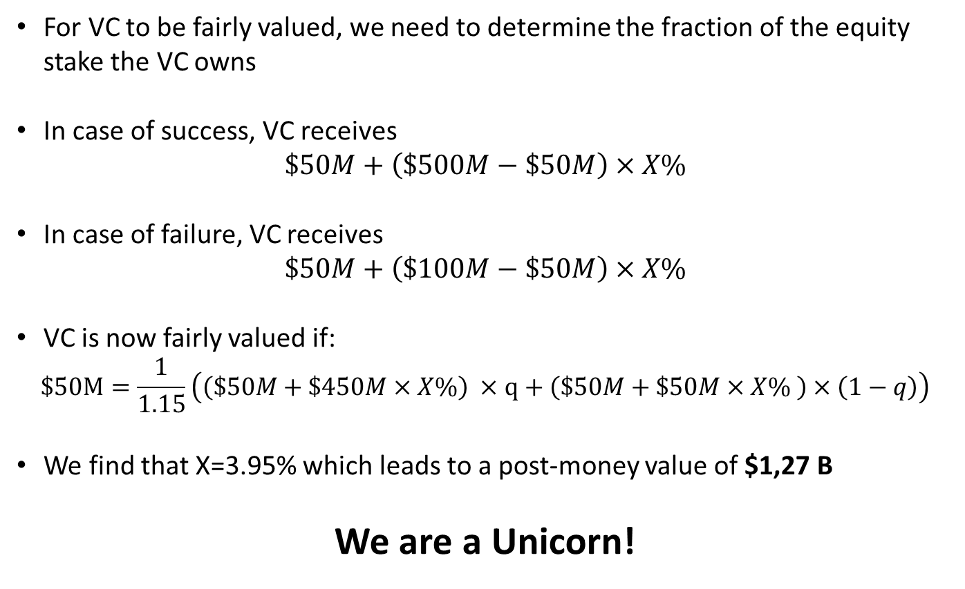
LiquidX: Becoming a unicorn
For VC to be fairly valued, we need to determine the fraction of the equity stake the VC owns
In case of success, VC receives
$$\$50M+\left(\$500M−\$50M\right)×X\%$$
In case of failure, VC receives
$$\$50M+\left(\$100M−\$50M\right)×X\%$$
VC is now fairly valued if:
$$\$50M=\frac{1}{1.15}\left(\left(\$50M+\$450M×X\%\right) ×q+\left(\$50M+\$50M×X\% \right)×\left(1−q\right)\right)$$
We find that X=3.95% which leads to a post-money value of $1,27 B
We are a Unicorn!

Slide 31
Post-money valuation does not equal value
Takeaways
Investors & E: Valuations are usually above the true "value" of companies
Investors: Consider using contractual features to inflate valuations and
avoid down rounds
E: Your stock options may not be as valuable as you thought

